Slide 1
Amino Acid and Protein Biosynthesis

Slide 2
Quiz Question #1
Which amino acid does not depend on the presence of an amino acid precursor for biosynthesis?
Alanine
Asparagine
Tyrosine
Arginine

Slide 3
Quiz Question #2
What is a transamination reaction
The transfer of ammonia to urea for disposal
The removal of an amino group releasing ammonia
The transfer of an amino group from one molecule to another
The removal of an amino group from an amino acid for degradation

Slide 4
Updates on the Midterm
Question 6, correct answer was ATP and was mis-scored I will add 2 points to anyone who picked ATP
Questions 3, 5 and 14 Dr Anderson and I commented on our thoughts on which answer was correct and our logic. Please look at the Multiple Choice Question Discussion
For Long Answer Questions
Email Dr. Anderson or I to make an appointment to discuss any issues you have for long answer questions.

Slide 5
Tentative Grade Schema
Overall Score | Projected Grade
Under 70 | C
70-75 | B
75-80 | B+
80-85 | A-
85+ | A

Slide 6
Learning Objectives
Understand the mechanistic differences that explain the difference between dispensable and indispensable amino acids.
Describe the central role of glutamate as a pool of nitrogen.
Describe the relationships between the glycolytic and TCA cycle intermediates and amino acid biosynthesis.
Explain why cysteine and tyrosine are dispensable only if precursors are available.
Understand how amino acid biosynthetic rates are controlled by utilization and by negative feedback.
Understand the role that the indispensable amino acids play in controlling protein synthesis.

Slide 7
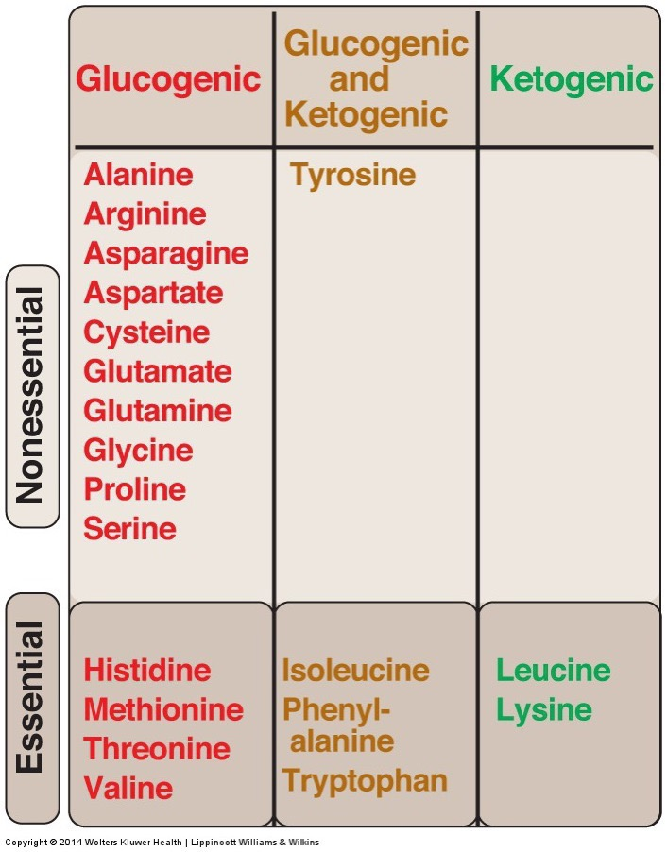
Essential vs Non-Essential Amino Acids
Arginine is sometimes considered essential because while we can make it, it is difficult. This is especially true for rapidly growing individuals
Notes:
Mention conditionally essential

Slide 8
TCA Cycle and Amino Acid Biosynthesis
PH
Many amino acids are derived from glycolytic and TCA intermediates
3-Phosphoglycerate
Phosphoenolpyruvate
Pyruvate
Oxaloacetate
α-Ketoglutarate
Notes:
A caveat about your biochemistry textbooks

Slide 9
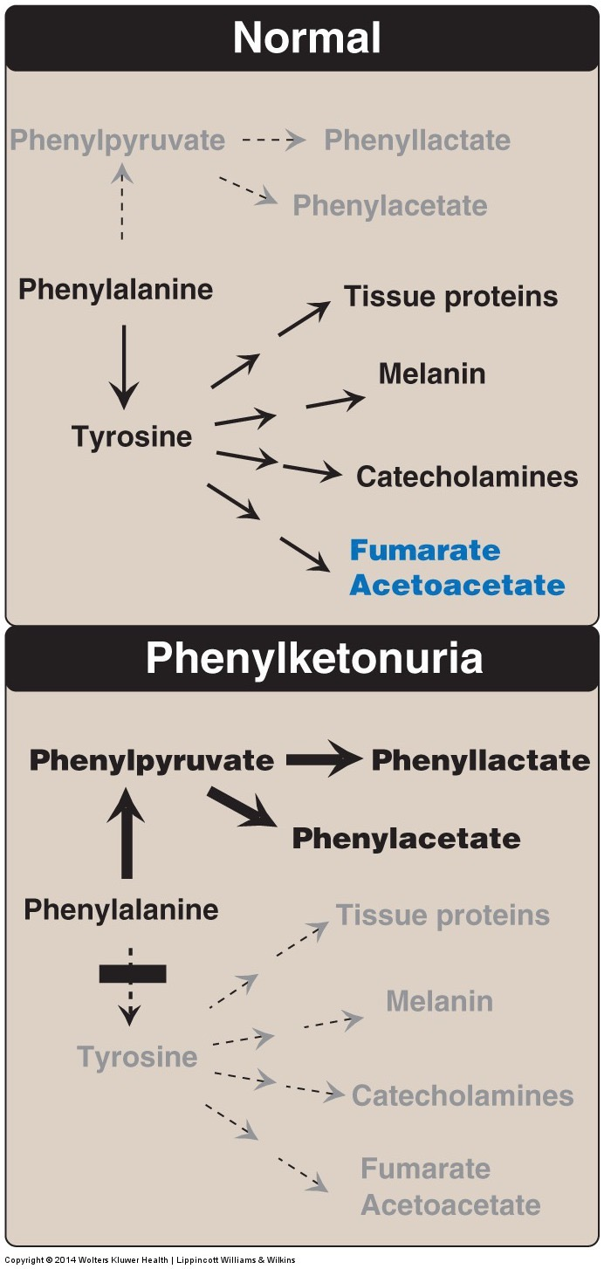
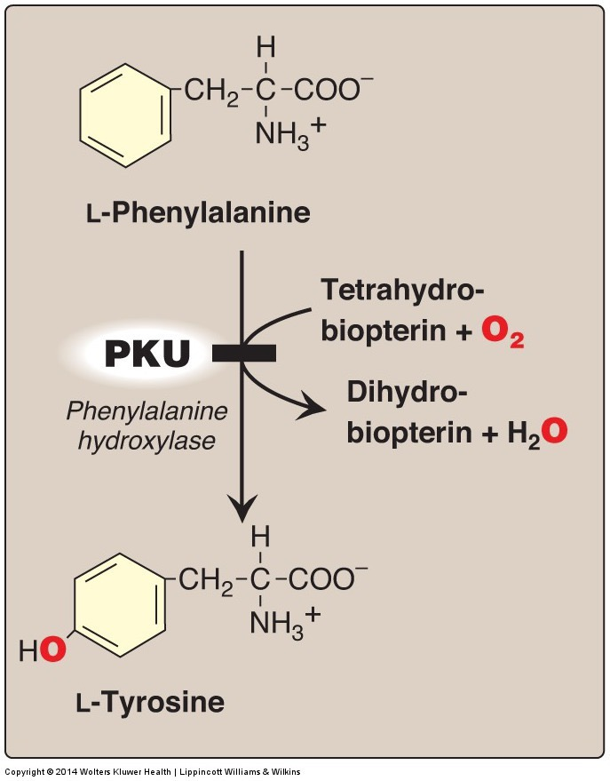
A Little More About PKU
Buildup of Phenylacetate and Phenyllactate is pathological
Inability to make Catecholamines and Melanin without supplemental tyrosine

Slide 10
Two Kinds of Amino Acid Biosynthetic Reactions
Single Step (Transaminase)
Multiple Step
Fast and Bioenergetically neutral
Controlled by Supply and Demand
Ala, Asp, Glu
Committed steps
Controlled by Feedback Inhibition
Ser, Cys, Gly, Asn, Pro, Arg, His

Slide 11
Feedback Inhibition of Multi-step Processes
-
Cysteine
Serine

Slide 12
Transamination Reactions Allow for Rapid Exchange of Amino Groups to Balance Amino Acids

Slide 13
Reversible Transaminase Reactions Allow for Rapid Exchange of Amino Acids
Substrates |  | Enzyme | Products
Pyruvate | Glutamate | ALT | Alanine | α-Ketoglutarate
Oxaloacetate | Glutamate | AST | Aspartate | α-Ketoglutarate

Slide 14
Supply and demand controls the levels of the amino acids from the transaminase reactions
Driving towards Alanine
Driving towards Pyruvate
Supply?
Demand?
Supply?
Demand?

Slide 15
Glutamate Buffers the Nitrogen Pool
10 of the 11 biosynthetic reactions involve glutamate
Alanine – from Pyruvate/Glutamate
Aspartate – from Oxaloacetate/Glutamate
Serine – from 3-Phosphoglycerate/Glutamate
Cysteine – From Serine
Glycine – From Serine
Downstream of Glutamate
Proline
Glutamine
Arginine
Histidine
Not Tyrosine (Phenylalanine hydroxylase)
Notes:
What does this mean for conditionally essential

Slide 16
Regulation of Glutamate Dehydrogenase
Tends to Make αKG by
ADP, GDP
BCAA and their metabolites
NAD
Tends to Make Glu by
αKG
NADPH
ATP, GTP
Ammonia

Slide 17
Where is Glutamate Generated From?
Supply from transaminase reactions (ie Alanine/Aspartate)
Deamination of glutamine by glutaminase

Slide 18
Glutamine levels vs other amino acids in tissues

Slide 19
Amino Acid Biosynthesis from Glucose
If someone is trying to build more protein, and needs more of a dispensable amino acid what are they drawing from.
Pick a non-essential amino acid and sketch out the pathway by which that amino acid could be made from either glucose and what conditions (regulatory steps) would need to be passed.

Slide 21
Regulation of Protein Biosynthesis

Slide 22
Should there be external control of amino acid biosynthesis
Yay or Nay?

Slide 23
What happens if amino acids are unavailable
Protein synthesis will stall if both essential and non-essential amino acids are not sufficiently available
Therefore the cell needs to be able to detect essential AA levels and respond to them

Slide 24
mTORC1 Senses Some of the Essential Amino Acids
Activated by several signals:
Essential Amino Acids
Arginine
Lysine
Leucine
Insulin
Energy Levels (via AMPK)

Slide 25
mTORC1 Activity Leads to More Protein Synthesis
Amino Acids

Slide 26
Hormonal Regulation of Protein Synthesis
Hormone | Effects on Protein Synthesis | Effects on Protein Degradation
Insulin | Promotes | Blocks
Glucocorticoids | Blocks | Promotes
Growth Hormone/IGF1 | Promotes | Blocks
Testosterone | Promotes | Blocks

Slide 27

Protein Synthesis

Slide 28
Energy Costs of Protein Production
For every peptide bond you need 4 ATP equivalents
Actin has 374 amino acids
How many molecules of glucose are needed to make Actin’s peptide bonds
If only glycolysis (8 ATP/glucose)
If glycolysis/TCA/ETC (36 ATP/glucose)
Step | Cost
Making Amino–Acyl tRNA | 2 ATP bonds ATP -> ADP ->AMP
Binding of tRNA | 1 GTP
Elongation | 1 GTP

Slide 29
Learning Objectives
Understand the mechanistic differences that explain the difference between dispensable and indispensable amino acids.
Describe the central role of glutamate as a pool of nitrogen.
Describe the relationships between the glycolytic and TCA cycle intermediates and amino acid biosynthesis.
Explain why cysteine and tyrosine are dispensable only if precursors are available.
Understand how amino acid biosynthetic rates are controlled by utilization and by negative feedback.
Understand the role that the indispensable amino acids play in controlling protein synthesis.

